Slide 1

Masters of Science Applied Data Science Project Portfolio Milestone Anthony Champion March 18th, 2020

Slide 2
Introduction
What is Data Science:
“Data science is the field of study that combines domain expertise, programming skills, and knowledge of mathematics and statistics to extract meaningful insights from data. Apply machine learning algorithms to numbers, text, images, video, audio, and more to produce artificial intelligence (AI) systems to perform tasks that ordinarily require human intelligence. In turn, these systems generate insights which analysts and business users can translate into tangible business value.”
https://www.datarobot.com/wiki/data-science/
For the purposes of this presentation, I will focus on the four projects that illustrate the core learning objectives for the Applied Data Science (ADS) program at Syracuse University.
IST 659: Database Management
IST 644: Managing Data Science Project
IST 707: Applied Machine Learning
IST 718: Information Visualization

Slide 3
Applied Data Science Learning Objectives
Describe a broad overview of the major practice areas in data science.
Collect and organize data.
Identify patterns in data via visualization, statistical analysis, and data mining.
Develop alternative strategies based on the data.
Develop a plan of action to implement the business decisions derived from the analyses.
Demonstrate communication skills regarding data and its analysis for managers, IT professionals, programmers, statisticians, and other relevant professionals in their organization.
Synthesize the ethical dimensions of data science practice.

Slide 4
Portfolio Project Background and Scope
IST 659
Data Administration Concepts and Database Management
IST 644
Managing Data Science Projects
IST 707
Applied Machine Learning
IST 719
Information Visualization
Choosing the right project management approach
Taiwan Credit Card Defaults
Revenue or Income: What is the best investment driver?
Daily Fantasy Football
Choosing the most unpredictable position in the daily fantasy football
SQL and Database illustration software
Leveraged common IT project management framework and focused those learnings on how to manage Data Science projects versus traditional IT projects
Identify potential customers that will default on credit card payments
Used multiple machine learning approaches Random Forest, Naïve Bayes, KNN, and SVM
Utilized R-Studio for the analysis
Used data representing the top Fortune 1000 companies on the NYSE
Created poster that expressed the importance of Income vs. Revenue for investment decisions
Utilized R-Studio to create base graphics and Adobe-Pro for visualization manipulation

Slide 5
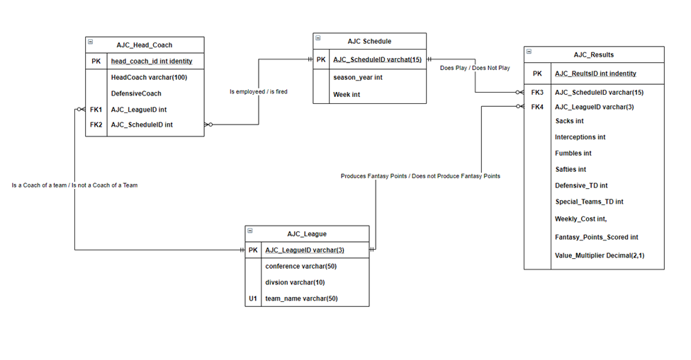
Data Collecting, Cleaning, and Organization
IST 659 – Daily Fantasy Football – Choosing Team Defense
Multiple data set
Creating Primary Keys
Join Statements
Data Structure

Slide 6
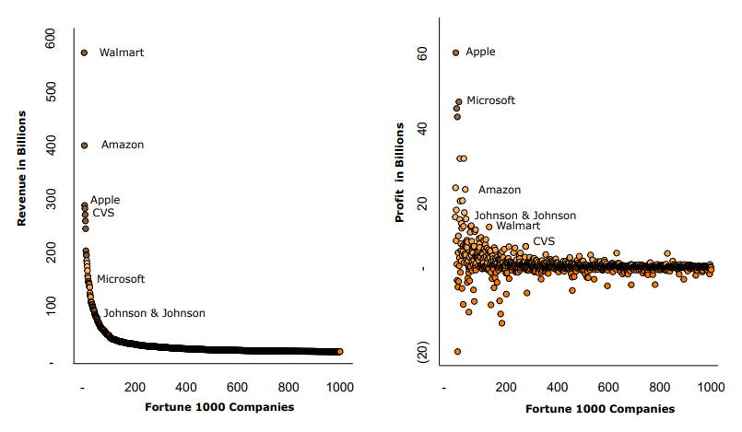
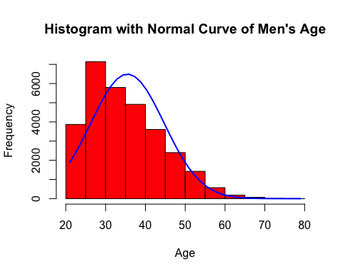
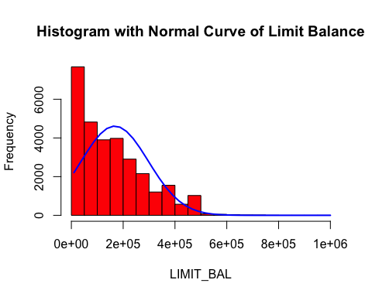
Identifying Patterns in the Data
Data Exploration and Visualization
Fortune 1000 NYSE companies Revenue versus Income tells a different story. Just because you have sales doesn’t always corollate to having income.
Below are histogram views that show the distribution of data for the age of male customers and well as the credit limit of the credit cards of each customer (male or female)
IST 707 – Applied Machine Learning
IST 719 – Revenue or Income to make investment decisions

Slide 7
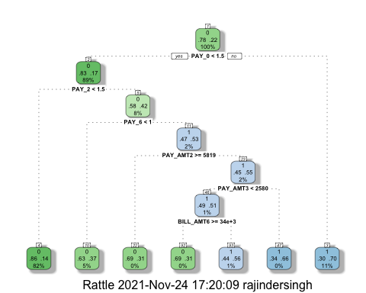
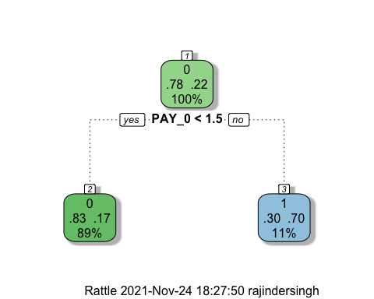
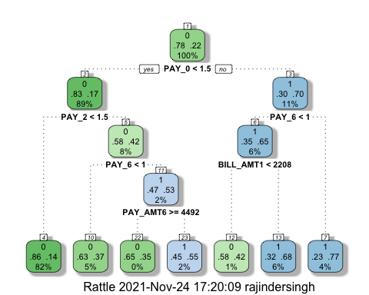
Identifying Patterns in the Data
Base
Preprune
Postprune
Predicting Credit Defaults
Decision Tree: 36.02%
Naïve Bayes: 86.6%
SVM: 68.34%
KNN: 36.18%
Reducing variables during the pruning staged yielded favorable results.

Slide 8
Implementing a Plan of Action
Managing Data Science Project – IST 644
This is was most important class during the program for me.
Managing a data science project and finding the best possible / scalable solution is always the goal.
Communication
Finding the right use case
Developing a timeline everyone can agree to
Defining deliverables upfront
Everyone knows their individual role and expectations
~80% of all data science models end up on a desktop never used
Implementing a Project Plan
In almost every class that required a project I viewed myself as the leader. Leveraging my experience in corporate America I felt that I truly added value in all my group projects because of this.
Part of the process included building a plan that included
Find dataset
Develop Algorithm
Work with team on code review
Presenting findings to class
Communication and inclusion were the success to all my group projects

Slide 9
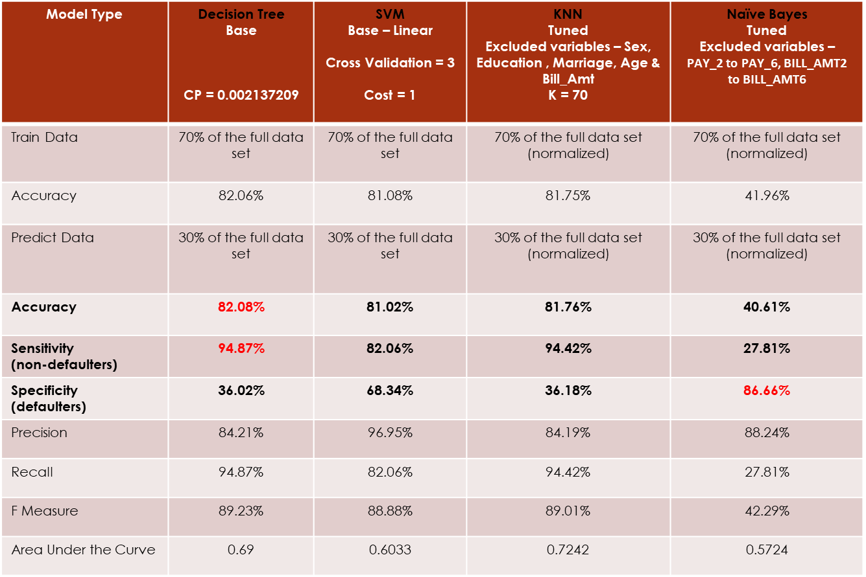
Alternative Strategies
For the Taiwan Credit Default project in IST 707 – Data Analysis, the use case was to determine customers that will potentially default.
As you can see below the Random Forest model, first gave us great results on finding customers that would not credit default (~94.87%). But the use case was to find customers who would default.
As an alternative method, we ran multiple models and determined Naïve Bayes answers the question at the highest level of accuracy.

Slide 10

Ethical Dimensions of Data Science
Data Science as it respects to information policy and regulation is severely underserved
Advancement in technology and the types of data collected (retail, banking, app purchases, etc.) have created many ethical issues.
The amount of sensitive data available in the medical space, access to personal identification, or even financial records such as banking documents are available more today then ever before. As a data science professional understanding how far to go with this type of data is key
Ethical bias in males and white / Caucasian work force in data science
Communication and open-door policy

Slide 11
Additional Projects in ADS Program
MBC 638: Data Analysis and Decision Making
Lower weekly food cost (Y), tracking daily spending by time, day, and type of food
IST 687: Introduction to Data Science
Predicting forest fires in northern Portugal, using different ML approaches
IST 623: IT Security
Data breach overview of the Ashley Madison scandal
IST 718: Big Data Analytics (Currently Taking)
Predicting winner and losers of the NBA regular season, using different ML approaches
IST 618: Information Policy (Currently Taking)
Research paper on access and affordability
No Final Projects:
SCM 651: Business Analytics
ACC 652: Accounting Analytics
FIN 653: Financial Analytics (Currently Taking)

Slide 12
Conclusion
Coming into Syracuse University with a very limited knowledge of Data Science. I can say with the utmost confidence that I know have the educational background in this space to really change my career trajectory.
This program was extremely meaning in my current role, for the past 18 months I have taken each weeks learning and directly applied them. This degree has given me credibility among my data science team. Which in turn has created a more inclusive environment that is creating sustainable data science solutions.
Coming into the program having limited math and coding background I’m impressed with how this was taught and walk away with a much larger knowledge base in this space
I will leave Syracuse University with a much larger set of tools then when I started. This give me all the confidence I need to tackle challenging data science problems.
Github Link to Project Portfolio:
https://github.com/Champioa00/Portfolio-Milestone

